Slide 1

Time Management Workshop
Notes:
Welcome to the time management course.
We understand that you’re quite busy and have a lot to juggle in your program. So, Library and Learning Services developed this workshop to help you better manage your time.
Now, nothing I’m going today is groundbreaking news…I think we all know the keys to time management. I’m here to remind you and to help you realize the options that work best for you.
Everyone can learn to manage time better; there’s always room for improvement
Throughout this workshop, I’ll be presenting tips and asking you if you can think of any others. If you can think of any other tips, please share – could be quite helpful to your fellow students.

Slide 2
Time Management
Learning Outcomes
At the end of this workshop you will:
Understand your own, unique approach to time management and the obstacles that get in your way.
Be aware of good time management habits and tools.
Identify time management tools and strategies that will work best for you.
Know where to get more information/assistance on how to manage time better.
Notes:
You already saw this on the poster, but here are the objectives for today.

Slide 3
Time Management
Outline
Introduction
Icebreaker activity
Definition of time management
Time management benefits and consequences
Know yourself
Time Management Self-Assessment Questionnaire
Some reasons for poor time management
Establishing Good Habits & Using Tools
Setting goals and scheduling
Fighting procrastination
Managing distractions
Avoid overscheduling
Getting further help
Monitoring your progress
Notes:
Be prepared: there’s lots of handouts in today’s session.

Slide 4
Introduction
Icebreaker Activity
Handout #1: Where does the time go during a typical college week?
Form small groups of 2-3 students and work together to complete the handout. Keep in mind that a week consists of 168 hours.
Discuss how much time a student should spend on each activity.
Add in any other activities you think are important.
Add up the total number of hours.
Discussion:
Which activity was assigned the most hours in your group?
What was the most challenging part of this activity?
Notes:
e.g. Sleep = 8 hours per night x 7 = 56 hours/week

Slide 5

Time Management
Definition
Definition
A set of skills and behaviours that make the most effective use of time while performing activities related to one’s goals (Claessens et al., 2007).
Why it’s important
Current research has shown that time-related demands are a serious problem for many students (Häfner & Stock, 2015).
Questions:
What are some benefits of managing time well?
What are some of the consequences of poor time management for students?
Notes:
Many different definitions of time management. This particular one was chosen because it emphasizes two things:
Time management is a collection of different skills and behaviours – Time management is a generic term for a set of skills and behaviours.
Having predetermined goals is an important part of time management
POTENTIAL ANSWERS - Some benefits:
Able to reach your goals
Accomplishment
Maintain balance
Meet deadlines
Reduce stress
Be in control of your time/your life
Do well academically
Reduced guilt
POTENTIAL ANSWERS - Some consequences:
Wasted time
Missed deadlines
Poor quality work
Stress
Declining academic performance
Lack of sleep
Poor diet
Risk of dropping out (Heibutzki, 2016)

Slide 6

Time management
Skills and Behaviours
The good news is, it is possible for anyone to improve how they manage their time.
Time management is made up of a set of skills and behaviours that need to be learned and practiced, and eventually these become habits.
The first step is identifying your current approach to managing time (Vences Cyril, 2015).

Slide 7
Know Yourself: Time Management Self-Assessment

Slide 8

Know Yourself
Questionnaire
The first thing to do is to evaluate how you’re currently managing your time, in particular:
What is working well?
What isn’t?
Activity: Time Management Self-Assessment Questionnaire
The questionnaire gives you a chance to look specifically at your patterns and consider the decisions that you make.
Complete the questionnaire individually.
Handout #2: Questionnaire
Notes:
See instructions on questionnaire.
Note to students: reflect on past schoolwork tasks the best you can. Be as honest as you can!

Slide 9
Reasons
Poor Time Management
Some Reasons for Poor Time Management:
Not setting/not prioritizing goals
Procrastinating
Not managing distractions well
Taking on too much/overscheduling
Not getting support
Can you think of any potential solutions to these problems?
Notes:
These five reasons come from the negative components from the questionnaire
Previewing activity: Think about some solutions,. In the next section each problem will be examined potential solutions put forth.

Slide 10

Your reasons
Record your reasons
HANDOUT #3: Time Management Worksheet
Fill out Section A:
“My reasons for poor time management”
Next:
The next section is devoted to helping you establish good habits and use time management tools to stay on track.
As you listen to the different types of strategies, fill out Section B: “Strategies that I want to implement”
Notes:
REMIND THEM When filling out Handout #3:
Review your answers on the “Time Management Self-Assessment Questionnaire”

Slide 11
Establishing Good Habits and Using Tools:
Setting Goals & Scheduling
Fighting Procrastination
Managing Distractions
Avoid Overscheduling
Getting Further Help
Monitoring Progress
Notes:
Here we look at each of the 5 reasons more in depth and provide some solutions

Slide 12
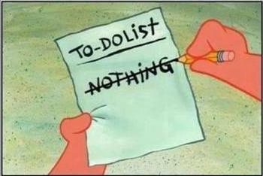
Goals

Slide 13

goals
Setting goals
Discussion Question: Why is it important to set goals?
How to set goals:
Think about bigger goals you want to accomplish, for example: “Become a graduate” or “Find a career that I enjoy.”
These are long-term goals: what you want to accomplish in 3-5 years, or even over a lifetime.
In order to achieve these long-term goals, you need to set and achieve a series of semester, weekly and daily goals.
Notes:
PROVIDE THIS ANSWER AFTER DISCUSSION: Setting goals makes you aware of the bigger picture, which helps you focus, become more motivated, and plan time more wisely.

Slide 14

Goals
Semester goals
The goals you set during the first 3 weeks of a semester affect your performance for the rest of the semester (Van Blerkom, 2012).
Activity: Planning out your semester
Take out one of the course outlines for a current course.
Look at Handout #4: Semester plan for Winter 2017 and record all evaluations. Include what % each evaluation is worth, so that you can prioritize effectively.
Also, record all other important dates that will occur throughout the semester: birthdays, concerts, dentist appointments, etc.
Notes:
Plan for early success: Many students think that the first few weeks of a semester are a breeze: no exams, few assignments, projects and presentations
By planning out your semester you can start building effective habits
[NOTE: IF THEY DIDN’T BRING THE COURSE OUTLINE, CAN ACCESS IT ON THEIR LAPTOP/PHONE THROUGH SLATE]
EVAULATIONS: assignments, quizzes, tests, presentations, exams, etc.
[TELL STUDENTS:] Later, do the same with all of your other course outlines.

Slide 15

Goals  tasks
Break down semester goals
To meet semester goals, such as completing a research paper, you’ll need to break each down into corresponding steps. For example:
Finish Research Paper - Steps:
Read over (and understand) assignment sheet
Conduct a library database search
Choose a topic
Come up with a thesis/research question
Brainstorm sub-topics
Create notes
Create an outline
Write a rough draft, etc.
These are actionable tasks and should be scheduled weekly and daily.
Notes:
Of course the tests, assignments, presentations don’t represent ALL the work you’ll be doing. There are many steps involved for each of the assessments you wrote down
You can attain almost any goal by planning out your steps and working out a timeframe.
In terms of time management, you can stay ahead by recognizing the tasks involved and scheduling them.
FYI: HANDOUT: ASSIGNMENT BREAKDOWN TEMPLATE

Slide 16
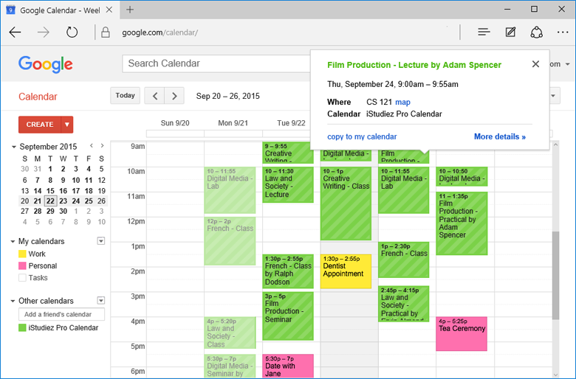
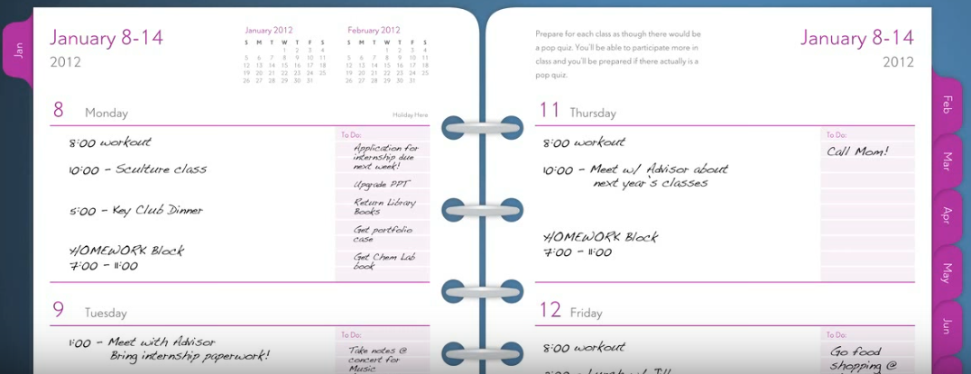
Task Scheduling
Weekly
Each week, create a schedule with tasks that are to be completed
Examples: a day-timer or an online calendar such as Google Calendar or Outlook Calendar.
As you’re scheduling, prioritize by:
due date
level of difficulty
how long each should take
the grade it’s worth
Notes:
ASK: Are you using either type of weekly right now?
Which works better for you?

Slide 17
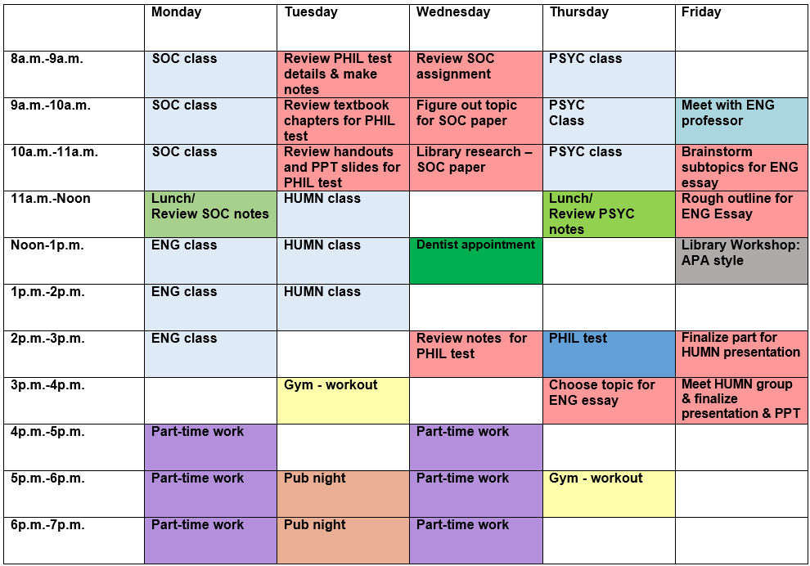
Weekly calendar
Sample
Notes:
Sample weekly calendar
[QUESTIONS:]
What do you think of this type of scheduling?
What would you do differently? [due date; duration – take a whole hour?; grade percentage]
[PROMPT TO QUESTION SOME OF THE CHOICES, i.e. what do you think of the empty blocks of time? What do you think of devoting an hour to reviewing their SOC assignment?]

Slide 18
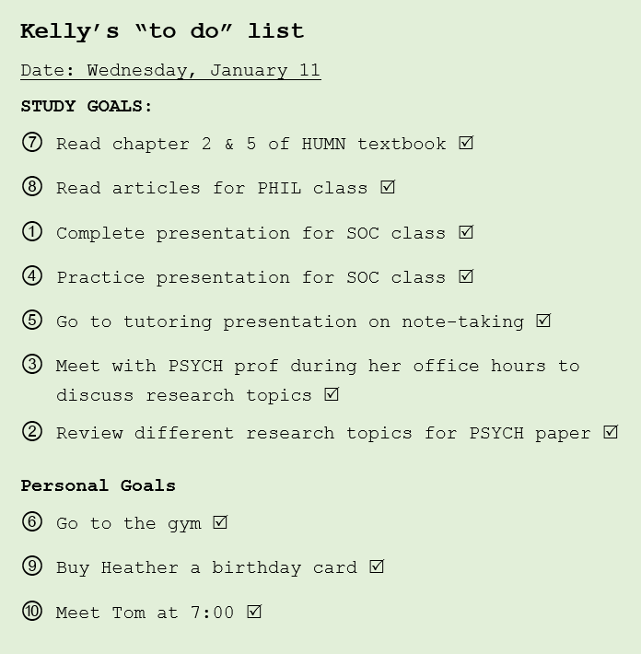
Scheduling tasks
Daily: Sample To-Do List
It’s recommended that you create a to do list each day.
Here’s a sample of a daily to-do list.
What do you notice about this list?
Notes:
As well, each day it’s recommended that you keep a to-do list.
For example…
ASK STUDENTS: What do you notice about this “to do” lists?
[PROMPT FOR ANSWERS LIKE THESE:]
Prioritized by number ranking system
Personal goals at the bottom
Can be accomplished in one day
Checked off
Is it reasonable that this person can accomplish this in one day?

Slide 19
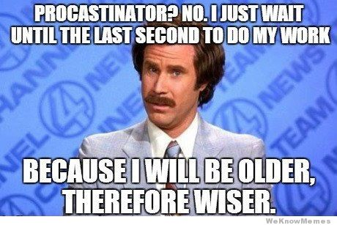
Procrastination
Why do we procrastinate?

Slide 20

Procrastination
Why do we procrastinate?
There are several different reasons for procrastinating, some which include:
Lack of motivation: “I don’t feel like doing it”
Overwhelmed, lack of skills: “I don’t know how to”
Fear of failure: “What if I can’t cut it?”
Fear of success: “How can I top this?”
Lack of interest: “This stuff is so boring”
Rebellion and resistance: “You can’t make me” (Burns, 1993)
Notes:
Note: more than just laziness

Slide 21
Procrastination
Fighting procrastination
Change your thinking:
Recognize your patterns
Identify the issue or roadblock
Reflect on the successes you’ve already achieved
Figure out why it’s important to get it done
Make it easier for yourself:
Plan out the steps
Devote time
Recognize and gather resources
(“Motivation Techniques,” 2012)
Notes:
Recognize your patterns – what do you typically procrastinate on?
Identify the issue or roadblock – See the reasons on the previous slide. Do any of them relate to you?
Reflect on the successes you’ve already achieved – You’ve already had many successes in your life. How have you accomplished what you have?
Figure out why it’s important to get it done – Keep the bigger picture in mind
ASK: CAN YOU SEE ANY OF THESE WORKING FOR YOU? REMIND THEM ABOUT HANDOUT #3, PART B (STRATEGIES THAT I WANT TO IMPLEMENT)

Slide 22
Procrastination
Fighting procrastination
Just do it:
Do it first. Do it right away
Just start with 10 minutes
Start with the easy tasks or start with the hard ones (what works best?)
Rewards & Accountability:
Find a partner/support system
Establish rewards for yourself
Create competition
Share your plan
(“Motivation Techniques,” 2012)
Any other suggestions?
Notes:
Just start with 10 minutes – tell yourself that you’ll only have to work on something for 10 minutes. Oftentimes you’ll find that you don’t want to stop after 10 mins. And if you do, at least you’ve started.
Do it first. Do it right away: Instead of telling yourself “I’ll do it later” just do it
Start with the easy tasks or start with the hard ones (what works best?). I think we’ve all heard start with the hard tasks first. However, that doesn’t work for all people…sometimes we need to start with the easy tasks to motivate us. BUT: if you do your difficult tasks first, your other tasks won’t seem so bad.
Create competition: try to be better than the day before

Slide 23

Distractions
Types of distractions
Distractions can be found both externally and internally. For example,
External:
Text messages, emails, social media
Surfing the internet, video games, TV
Noise, other people
Internal:
Physical distractions (e.g. irregular sleep, not exercising, not eating well)
Negative self-talk
Personal issues
Indecision
Confusion
(“Managing distractions,” n.d.)
Notes:
self-talk – sabotaging your efforts before you begin. For example, comparing your abilities to others

Slide 24

Distractions
Managing distractions
External:
Texts and email: Shut down phone, email, etc, when you’re trying to work
Social media: Allow yourself a 10-minute break each hour to check
Internet: Block access/limit specific websites on your computer or cellphone
TV/Video games: Use TV and video games as a reward
Noise: Find a quiet place to study; Cover up noise with music that helps focus
Other people: Tell people that you're busy
(“Managing distractions,” n.d.)
Any other suggestions?
Notes:
ELICIT ANY OTHER SUGGESTIONS FROM STUDENTS
REMDINDER: add any to Handout #3, Part B (“strategies that I want to implement)

Slide 25

distractions
Managing Distractions
Internal:
Physical distractions: Schedule time for healthy cooking, exercise and sleep.
Self-talk: refocus and “cut off” self-talk before it takes concentration away.
Personal issues: Understand that most problems will pass. If your issue is serious, seek help.
Indecision: Trust your instincts more; stop worrying about what others think.
Confusion: If you’re confused about assignment expectations, re-read the assignment sheet, and/or seek clarification from your professors or tutoring (“Managing distractions,” n.d.)
Any other suggestions?
Notes:
PHYSICAL DISTRACTIONS: Recognize how you treat your body affects intellectual functioning: ; try to treat yourself better
PERSONAL ISSUES: Most students have to deal with some type of personal disaster.
ELICIT ANY OTHER SUGGESTIONS FROM STUDENTS

Slide 26

Avoid Overscheduling
Not taking on too much
Feeling overwhelmed by all you have to do is common as a student. But there are ways to avoid overscheduling yourself:
When planning your time, be honest about your time commitments.
Delegate where you can (e.g. housework, cooking, shopping, child care).
Keep your long-term and semester goals in mind. Say no to extra tasks that don’t fit in with these goals.
If you have a part-time job, reflect on how it’s affecting your study time. If needed, cut down your hours or quit your job.
Any other suggestions?

Slide 27

Getting support
Helpful resources
Maintain a lifestyle that will give you enough energy
Join/form a study group.
Get help from a tutor at Sheridan.
Get help from help from a student advisor.
Be aware of all your professors’ office hours.
Ask for research and citation help from Sheridan’s librarians.
For assistance with choosing a career, visit Sheridan’s Career Services.
For international students, find resources at the International Centre.
If personal issues are proving to be overwhelming, seek help from Sheridan’s Counselling Services.
Handout #6: Getting more support
Notes:
INTRO: Some things that can help you stay on track include…
[PROVIDE HANDOUT: GETTING SUPPORT AT SHERIDAN]

Slide 28

Monitoring progress
Your progress
Set aside time each day to review whether your scheduling is working and whether new habits have formed. For example:
Were tasks broken down sufficiently for assignments/preparing for exams? (look at weekly scheduling and daily “to do” list)
Did you overestimate or underestimate how much time tasks took?
Did you rank tasks appropriately on your “to do” lists?
As well, reflect on how well you are dealing with your particular time management issues, for instance: are you managing to fight procrastination? Are you dealing better with distractions?
Are there any other strategies you can think of?
Notes:
INTRO: It’s important to review whether your new habits and the new tools you’re using are working for you, or if you need to make adjustments.
The only way to make change stick is by monitoring it and you’re the only one that can monitor your new habits.
ASK: If not what other strategies can you try?

Slide 29
Monitoring progress
Time log
Handout #7: Time Management Log – Where did your time go?
Logging your time:
Over the next week, record how much time each activity took each day.
Add in any other items.
Total up the number of hours for the week. Take this number and use it to find the percentage of each activity.
Reflect on your time log and ask yourself :
Are some activities taking up more time than needed?
Which activities can be reduced in order to help you better meet your goals?

Slide 30
Questions?

Slide 31
References
Burns, D. (1993). Ten days to self esteem. New York: Quill.
Claessens, B.C.J., van Erde, W., Rutte, C.G. & Roe, R.A. (2007). A review of the time management literature. Personnel Review, 36(2), 255 – 276.
Häfner, A., Stock, A., Oberst, V. (2015). Decreasing students’ stress through time management training: An intervention study. European Journal of Psychology of Education, 30(1), 81-94.
Managing distractions (n.d.) A guide to time management, University of Guelph Library, the Learning Commons. Retrieved from http://www.learningcommons.uoguelph.ca/guides/time_management/html/managing_distractions.html
Motivation techniques (2012). Academic Success Center, Oregon State University. Retrieved from http://success.oregonstate.edu/sites/success.oregonstate.edu/files/LearningCorner/Tools/motivation_techniques.pdf
Van Blerkom, D. L. (2012). College study skills: Becoming a strategic learner (7th ed.). Boston, MA: Wadsworth.
Vences Cyril, A. (2014). Time Management and Academic Achievement of Higher Secondary Students. Journal on School Educational Technology, 10(3), 38-43.

Slide 32
References
Image List
In order of appearance:
“Skills” icon by Rflor from the Noun Project.
“Clock” icon by Camelon Design from the Noun Project.
“Quiz” icon by Carlos Sarmento from the Noun Project.
“Writing” icon by ProSymbols from the Noun Project.
“Target” icon by Julia Stoffer from the Noun Project.
“Calendar” by Edward Boatman from the Noun Project.
“Simplify” by Chris Homan from the Noun Project.
“Success” by Becris from the Noun Project.
“Procrastinate” by Dairy Free Design from the Noun Project.
“Hypnosis” by Luis Prado from the Noun Project.
“Message” by Gregor Črešnar from the Noun Project.
“Internal” by Gregor Črešnar from the Noun Project.
“Stress” by Aenne Brielman from the Noun Project.
“Resources” by Andre Nolte from the Noun Project.
“Promotion” by ProSymbols from the Noun Project.

